Slide 1
第六章
IP路由

Slide 2



路由基础
10.120.2.0
172.16.1.0
路由:把1个数据包从1个设备发送到不同网络里的另1个设备上去.这些工作依靠routers来完成.routers并不关心主机的位置。它们只关心网络的状态和决定网络中的最佳路径
Notes:
Purpose: This figure introduces students to routing. The router must accomplish the items listed in the figure for routing to occur.
Emphasize:
Path determination occurs at Layer 3, the network layer. The path determination function enables a router to evaluate the available paths to a destination and to establish the best path.
Routing services use network topology information when evaluating network paths. This information can be configured by the network administrator (static routes) or collected through dynamic processes (routing protocols) running in the network.
Transition:
How do you represent the path to the packet’s destination?

Slide 3
10.120.2.0
172.16.1.0
要实现路由路由器必须知道:
  目的地址
  源地址
  所有可能的路由路径
  最佳路由路径
  管理路由信息

Slide 4


不同网络两台主机的通讯过程
主机A
主机B
E0
E1
172.16.10.2
172.16.10.1
172.16.20.1
172.16.20.2
1.主机A检查主机B的IP地址是否属于本网段。
2.主机A查看ARP缓存，是否有网关的映射。
3.主机A将目标MAC地址设为网关的地址，转发至网关。
4.路由器收到该数据帧之后，进行CRC校验，无误则检查目标MAC地址是否为本接口地址
5.提交至网络层，网络层检测目标IP地址，查找路由表。
6.路由器从E1接口转发数据包，修改数据包的相关字段，重新封装成帧。
7.转发至主机B。
Notes:
按照幻灯片思路讲解，然后按照课本的步骤过一遍，

Slide 5
几种不同类型的路由
1.静态路由(static routing)
2.默认路由(default routing)
3.动态路由(dynamic routing)

Slide 6
静态路由和动态路由
静态路由
  由网络管理员在路由器上手工添加路由信息以实现路由目的
动态路由
  根据网络结构或流量的变化，路由协议会自动调整路由信息以实现路由
Notes:
Purpose: This figure introduces students to static and dynamic routes.
Emphasize:
Static knowledge is administered manually—A network administrator enters it into the router’s configuration. The administrator must manually update this static route entry whenever an internetwork topology change requires an update. Static knowledge can be private—by default it is not conveyed to other routers as part of an update process. You can, however, configure the router to share this knowledge.
Dynamic knowledge works differently. After the network administrator enters configuration commands to start dynamic routing, route knowledge is updated automatically by a routing process. Whenever new topology information is received from the internetwork, routers update neighbors about the route change.

Slide 7

静态路由
Stub Network
172.16.1.0
SO
Network
A
B
172.16.2.2
B
172.16.2.1
  在小型网络中适宜设置静态路由。
Notes:
Purpose: This figure describes how a static route operates.
Emphasize: For intercommunication, static routes must be configured in both directions. Static routes are often used to route traffic to a stub network or other network where only a single route to that network exists.

Slide 8
静态路由
优点:
1.没有额外的router的CPU负担
2.节约带宽
3.增加安全性
缺点:
网络管理员必须了解网络的整个拓扑结构
如果网络拓扑发生变化,管理员要在所有的routers上手动修改路由表
不适合在大型网络中

Slide 9
静态路由的配置
Router(config)#ip route dest-network [mask]
{address | interface}[distance] [permanent]
  指定一条可以到达目标网络的路径
Notes:
Purpose: This figure describes the command syntax used to establish an IP static route.
Emphasize: A static route allows manual configuration of the routing table. No dynamic changes to this table entry will occur as long as the path is active. Routing updates are not sent on a link that is only defined by a static route; hence, conserving bandwidth.
Describe the The ip route field descriptions:
network—destination network or subnet
mask—subnet mask
address—IP address of next hop router
interface—name of interface to use to get to destination network.
Transition: The next figure provides a static route configuration example.

Slide 10
静态路由的例子
Stub Network
172.16.1.0
SO
Network
A
B
172.16.2.2
B
172.16.2.1
ip route 172.16.1.0 255.255.255.0 172.16.2.1
  这是一条单方向的路径，必须配置一条相反的路径。
Notes:
Purpose: This figure gives an example of a static route configuration.

Slide 11
默认路由
Stub Network
172.16.1.0
SO
Network
A
B
172.16.2.2
B
172.16.2.1
ip route 0.0.0.0 0.0.0.0 172.16.2.2
  使用默认路由后，Stub Network可以到达路由器A以外的网络。
Notes:
Purpose: This figure gives an example of a default route configuration.
Emphasize: With an address and subnet mask of 0.0.0.0 0.0.0.0 in the ip route statement, packets for any network not listed in the routing table will be sent to the next hop, 172.16.2.2.

Slide 12
主动路由协议和被动路由协议
主动路由协议(routing protocol):用于routers动态寻找网络最佳路径,保证所有routers拥有相同的路由表.
OSPF,RIP,IGRP,EIGRP等
被动路由协议(routed protocol):被动路由协议分配给接口,用来决定数据包的投递方式。
IP和IPX

Slide 13
路由协议
10.120.2.0
172.16.1.0
主动路由协议 用于路由器选择路径和管理路由表。
一旦选择了一条路径后，路由器将路由被动路由协议 。
E0
S0
Network
Protocol
Destination
Network
Exit Interface
172.17.3.0
Connected
RIP
IGRP
10.120.2.0
172.16.2.0
172.17.3.0
E0
S0
S1
被动路由协议: IP
路由协议: RIP, IGRP
Notes:
Purpose: This figure introduces students to routing protocols and compares routing protocols to routed protocols.
Emphasize: If network 10.120.2.0 wants to know about network 172.16.2.0, it must learn it from its S0 (or possibly S1) interface.
Note: The two routing protocols that will be taught in this course are RIP and IGRP. They are both distance vector routing protocols.

Slide 14

自治系统
IGPs: RIP, IGRP
EGPs: BGP
自治系统 100
自治系统 200
  自治系统：一个基于共同管理域下的网络集合，在一个AS中所有路由器共享相同的路由信息。
  IGP在一个自治系统内运行。
  EGP连接不同的自治系统。
Notes:
Purpose: This figure discusses autonomous systems, IGPs. and EGPs.
Emphasize: Introduce the interior/exterior distinctions for routing protocols:
Interior routing protocols are used within a single autonomous system
Exterior routing protocols are used to communicate between autonomous systems.
The design criteria for an interior routing protocol require it to find the best path through the network. In other words, the metric and how that metric is used is the most important element in an interior routing protocol.
Exterior protocols are used to exchange routing information between networks that do not share a common administration. IP exterior gateway protocols require the following three sets of information before routing can begin:
A list of neighbor (or peer) routers or access servers with which to exchange routing information
A list of networks to advertise as directly reachable
The autonomous system number of the local router

Slide 15
IGP与EGP
内部网关协议(IGP)：OSPF/RIP/IGRP/EIGRP/IS-IS
外部网关协议(EGP)：BGP

Slide 16
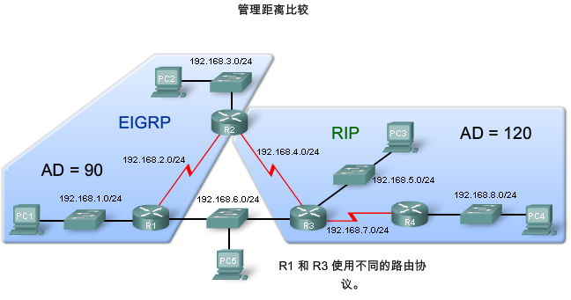
管理距离
管理距离（Administrative Distance）
这个数值用于指定路由协议的优先级

Slide 17
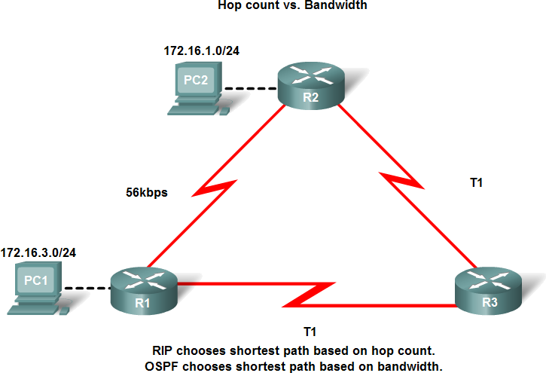
度量值
度量值（Metric） ：
路由协议根据度量值判定路由最佳路径，来创建和维护路由表。
常用度量：
  -带宽
  -开销
  -延迟
  -跳数
  -负载
  -可靠性
Notes:
Metrics used in IP routing protocols include:
Hop count - A simple metric that counts the number of routers a packet must traverse
Bandwidth - Influences path selection by preferring the path with the highest bandwidth
Load - Considers the traffic utilization of a certain link
Delay - Considers the time a packet takes to traverse a path
Reliability - Assesses the probability of a link failure, calculated from the interface error count or previous link failures
Cost - A value determined either by the IOS or by the network administrator to indicate preference for a route. Cost can represent a metric, a combination of metrics or a policy.

Slide 18
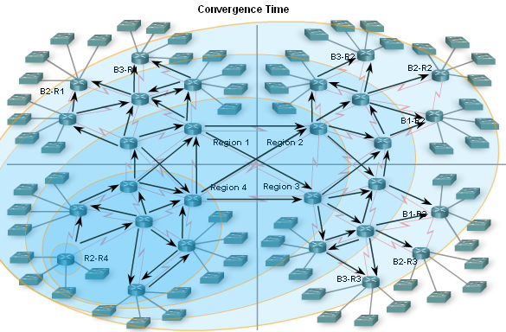
收敛时间
收敛时间 （convergence time):从网络拓扑发生变化到网络中所有路由器都知道这个变化的时间

Slide 19
路由协议的分类
距离矢量
B
C
A
D
混合路由
B
链路状态
C
A
D
Notes:
Purpose: This figure introduces the three classes of routing protocols.
Emphasize: There is no single best routing protocol.
Note: Distance vector routing protocol operation is covered in detail in this course. Link state and hybrid are only briefly explained after the distance vector discussion. Refer students to ACRC to learn more about link state and hybrid routing protocols.

Slide 20
距离矢量的路由协议
距离矢量:用于根据距离(distance)来判断最佳路径,当1个数据包每经过1个router时,被称之为经过1跳.经过跳数最少的则作为最佳路径.
RIP
IGRP

Slide 21
距离矢量的路由协议
B
C
A
Distance—How far
Vector—In which direction
D
D
C
B
A
Routing
Table
Routing
Table
Routing
Table
Routing
Table
定期将路由表复制给相邻的路由器并且进行矢量堆加
Notes:
Purpose: This figure introduces the distance vector routing algorithm, the first of the classes of routing protocols, and outlines how it operates.
Emphasize: Distance vector algorithms do not allow a router to know the exact topology of an internetwork.
This information is somewhat analogous to the information found on signs at a highway intersection. A sign points toward a road leading away from the intersection and indicates the distance to the destination.
Further down the highway, another sign also points toward the destination, but now the distance to the destination is shorter.
So long as each successive point on the path shows that the distance to the destination is successively shorter, the traffic is following the best path.

Slide 22
距离矢量—选择最佳路径
A
IGRP
Bandwidth
Delay
Load
Reliability
MTU
56
RIP
Hop count
T1
56
IPX
Ticks, hop count
T1
B
  用于确定最佳路由路径的参数信息
Notes:
Emphasize: How the routing algorithm defines “best” determines the most important characteristics of each routing algorithm.
Hop count—Some routing protocols use hop count as their metric. Hop count refers to the number of routers a packet must go through to reach a destination. The lower the hop count, the better the path. Path length is used to indicate the sum of the hops to a destination. As indicated in the figure, RIP uses hop count for its metric.
Ticks—Metric used with Novell IPX to reflect delay. Each tick is 1/18th of a second.
Cost—Factor used by some routing protocols to determine the best path to a destination; the lower the cost, the better the path. Path cost is the sum of the costs associated with each link to a destination.
Bandwidth—Although bandwidth is the rating of a link’s maximum throughput, routing through links with greater bandwidth does not always provide the best routes. For example, if a high-speed link is busy, sending a packet through a slower link might be faster. As indicated in the figure with highlighing,delay and bandwidth are comprise the default metric for IGRP.
Delay—Depends on many factors, including the bandwidth of network links, the length of queues at each router in the path, network congestion on links, and the physical distance to be traveled. A conglomeration of variables that change with internetwork conditions, delay is a common and useful metric. As indicated in the figure with highlighing,delay and bandwidth are comprise the default metric for IGRP.
Load—Dynamic factor can be based on a variety of measures, including CPU use and packets processed per second. Monitoring these parameters on a continual basis can itself be resource intensive.

Slide 23
路由信息协议Routing Information Protocol(RIP)
RIP是一种距离失量路由协议,使用跳数作为度,最大15跳,它每30秒向外发送整个路由表的信息.
RIP适合于小型网络
最多支持相同hop数的6条路径
19.2 kbps
T1
T1
T1

Slide 24
RIP路由信息获得
10.1.0.0
10.2.0.0
10.3.0.0
10.4.0.0
E0
A
S0
S0
B
S1
S0
C
E0
Routing Table
Routing Table
Routing Table
10.1.0.0
E0
0
10.2.0.0
S0
0
10.3.0.0
S0
0
10.2.0.0
S0
0
10.3.0.0
S1
0
10.4.0.0
E0
0
路由器从收集到的源信息中选择到达目标地址的最佳路径
Notes:
Layer 1 of 3:
Purpose: This figure continues the concept of how a router using a distance vector protocol generally discovers the best path to destinations from each router neighbor.
Emphasize: Layer 1 shows the topology consisting of four networks and three routers. Routing tables inside each router begin with entries for the 0 distance to directly connected networks.

Slide 25
RIP路由信息获得
10.1.0.0
10.2.0.0
10.3.0.0
10.4.0.0
E0
A
S0
S0
B
S1
S0
C
E0
Routing Table
Routing Table
Routing Table
10.1.0.0
E0
0
10.2.0.0
S0
0
10.3.0.0
S0
0
10.2.0.0
S0
0
10.3.0.0
S1
0
10.4.0.0
E0
0
10.3.0.0
S0
1
10.4.0.0
S1
1
10.2.0.0
S0
1
10.1.0.0
S0
1
路由器从收集到的源信息中选择到达目标地址的最佳路径
Notes:
Layer 1 of 3:
Emphasize: Layer 2 adds routing entries received some time later about noncontiguous networks that have distances of 1 from the given routers.

Slide 26
RIP路由信息获得
10.1.0.0
10.2.0.0
10.3.0.0
10.4.0.0
E0
A
S0
S0
B
S1
S0
C
E0
Routing Table
Routing Table
Routing Table
10.1.0.0
E0
0
10.2.0.0
S0
0
10.3.0.0
S0
0
10.2.0.0
S0
0
10.3.0.0
S1
0
10.4.0.0
E0
0
10.3.0.0
S0
1
10.4.0.0
S1
1
10.2.0.0
S0
1
10.4.0.0
S0
2
10.1.0.0
S0
1
10.1.0.0
S0
2
路由器从收集到的源信息中选择到达目标地址的最佳路径
Notes:
Layer 1 of 3:
Emphasize: Layer 3 adds the final entries received some time later that have distances of 2 from routers A and C.

Slide 27
RIP—管理路由信息
更新路由表
网络结构的
改变将导致
路由表的
更新
A
路由表的更新过程将通过路由器之间一步一步来完成
Notes:
Layer 1 of 3:
Purpose: This figure continues the concept of how a router using a distance vector protocol generally performs its routing information update process when the network topology changes.
Emphasize: This layer shows the bullet point, the router on the right, and, on the right, a topology change; routing tables will need updating to reflect this topology change.

Slide 28
RIP—管理路由信息
更新路由表
在下一个周期后
路由器A发送更新
过的路由表
网络结构的
改变将导致
路由表的
更新
A
路由表的更新过程将通过路由器之间一步一步来完成
Notes:
Layer 2 of 3:
Emphasize: Layer 2 adds the updated routing table that router A sends out after it processes the topology change.

Slide 29
RIP—管理路由信息
更新路由表
更新路由表
在下一个周期后
路由器A发送更新
过的路由表
网络结构的
改变将导致
路由表的
更新
B
A
路由表的更新过程将通过路由器之间一步一步来完成
Notes:
Layer 3 of 3:
Layer 3 adds router B, which receives the updated routing table from router A. In turn, router B will perform its own process to update its routing table given this new topology update from router A.
Distance vector updates occur step by step.
Typically, a router sends updates by multicasting its table on each configured port, but other methods, such as sending the table only to preconfigured neighbors, are employed by some routing algorithms.
Multicast is used by the RIP2, OSPF, and EIGRP routing protocols. RIP and IGRP use broadcast.
The routing table can be sent routinely and periodically, or whenever a change in the topology is discovered. Updates sent when changes occur are called triggered updates.

Slide 30
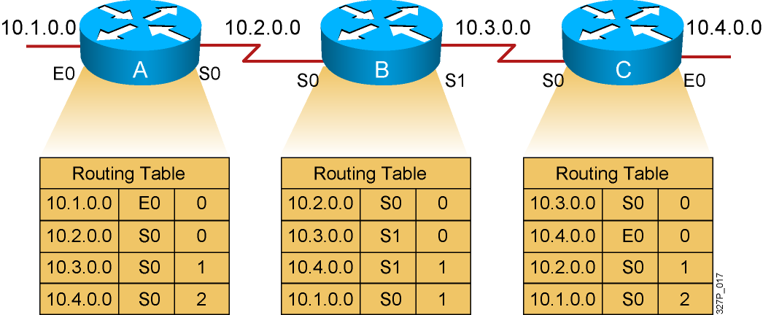
路 由 回 环
每一个节点保持着网络里面所有的路径信息
Notes:
Slide 1 of 4:
Prupose: This figure describes the first of the general problems that a distance vector protocol could face without the corrective influence of some countermeasure.
Emphasize: Layer 1 shows the original state of the network and routing tables. All routers have consistent knowledge and correct routing tables. In this example, the cost function is hop count so the cost of each link is 1. Router C is directly connected to network 10.4.0.0 with a distance of 0. Router A’s path to network 10.4.0.0 is through router B, with a hop count of 2.

Slide 31
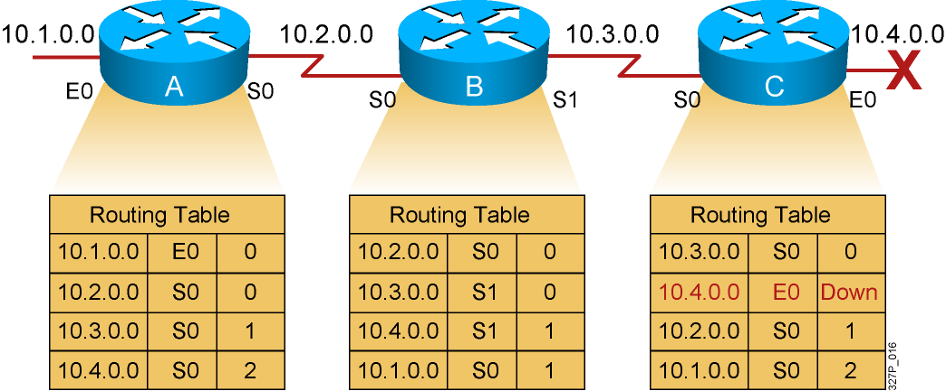
路 由 回 环
缓慢的收敛容易造成路由信息的不一致
Notes:
Slide 2 of 4:
Emphasize: In Layer 2, router C has detected the failure of network 10.4.0.0 and stops routing packets out its E0 interface. However, router A has not yet received notification of the failure and still believes it can access network 10.4.0.0 through router B. Router A’s routing table still reflects a path to network 10.4.0.0 with a distance of 2.

Slide 32
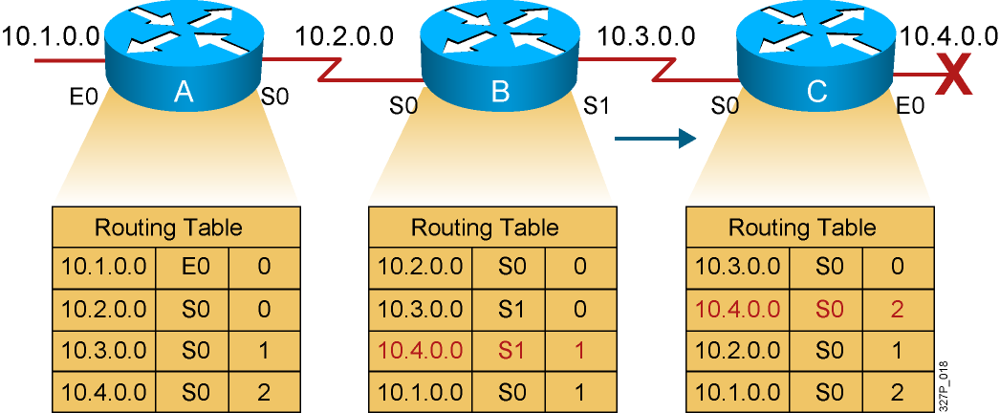
路 由 回 环
路由器C 推断到达10.4.0.0 网络的最好路径是通过路由器B
Notes:
Slide 3 of 4:
Emphasize: Because router B’s routing table indicates a path to network 10.4.0.0, router C believes it now has a viable path to 10.4.0.0 through router B. Router C updates its routing table to reflect a path to network 10.4.0.0 with a hop count of 2.

Slide 33
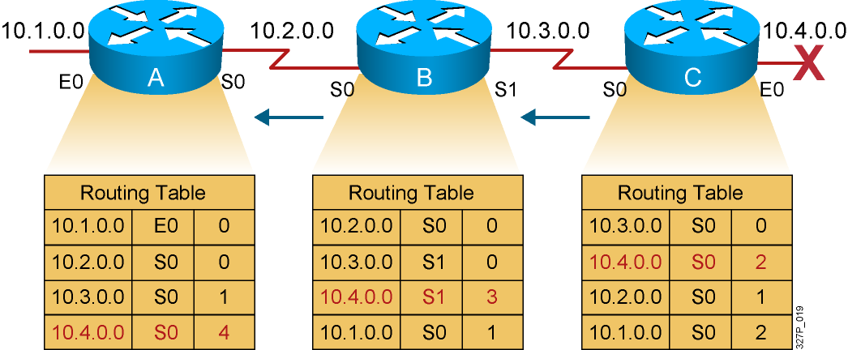
路 由 回 环
路由器 A 根据错误的信息升级它的路由表
Notes:
Slide 4 of 4:
Emphasize: In Layer 4, router A receives the new routing table from router B, detects the modified distance vector to network 10.4.0.0, and recalculates its own distance vector to network 10.4.0.0 as 3.
If all routers in an internetwork do not have up-to-date, accurate information about the state of the internetwork, they might use incorrect routing information to make a routing decision.
The use of incorrect information might cause packets to take less-than-optimum paths or paths that return packets to routers that they have already visited.

Slide 34
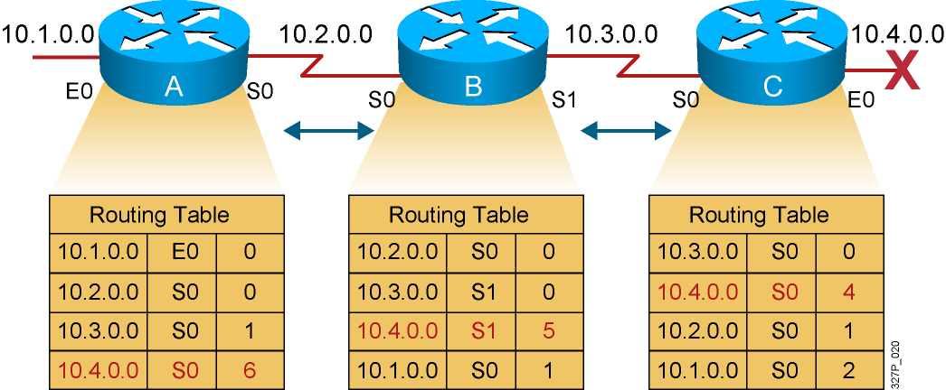
无 限 计 数
10.4.0.0 网络的跳数将无限大
Notes:
Purpose: This figure describes another of the general problems that a distance vector protocol could face without the corrective influence of some countermeasure.
Emphasize: Both routers conclude that the best path to network 10.4.0.0 is through each other and continue to bounce packets destined for network 10.4.0.0 between each other, incrementing the distance vector by 1 each time.
This condition, called count-to-infinity, continuously loops packets around the network, despite the fundamental fact that the destination network 10.4.0.0 is down. While the routers are counting to infinity, the invalid information allows a routing loop to exist.
A related concept is the Time-to-Live (TTL) parameter. The TTL is a packet parameter that decreases each time a router processes the packet. When the TTL reaches zero, a router discards or drops the packet without forwarding it. A packet caught in a routing loop is removed from the internetwork when its TTL expires.

Slide 35
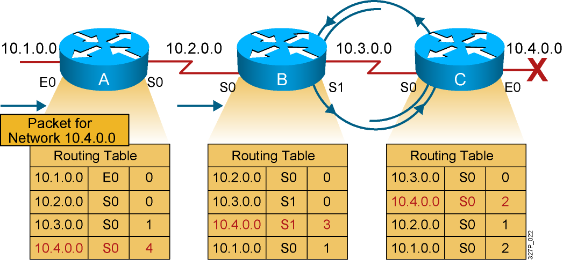
路由回环
10.4.0.0 网络的数据将在路由器 B 和 C 之间循环

Slide 36
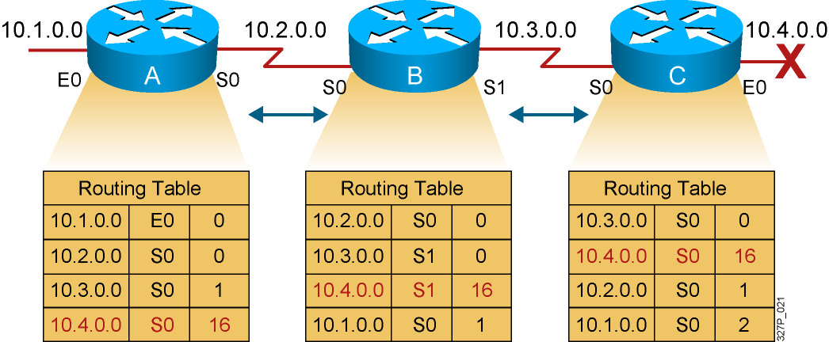
解决方法：定义最大跳数
指定最大跳数来防止路由回环
Notes:
Purpose: This figure describes a corrective measure that attempts to solve the routing loop problems that a distance vector protocol could face.
Emphasize: Routing loops occur only when routing knowledge being propagated has not yet reached the entire internetwork—when the internetwork has not converged after a change. Fast convergence minimizes the chance for a routing loop to occur, but even the smallest interval leaves the possibility open.
To avoid prolonging the count-to-infinity time span, distance vector protocols define infinity as some maximum number. This number refers to a routing metric, such as a hop count.
With this approach, the routing protocol permits the routing loop until the metric exceeds its maximum allowed value. This example shows this defined maximum as 16 hops. Once the metric value exceeds the maximum, network 10.4.0.0 is considered unreachable.

Slide 37
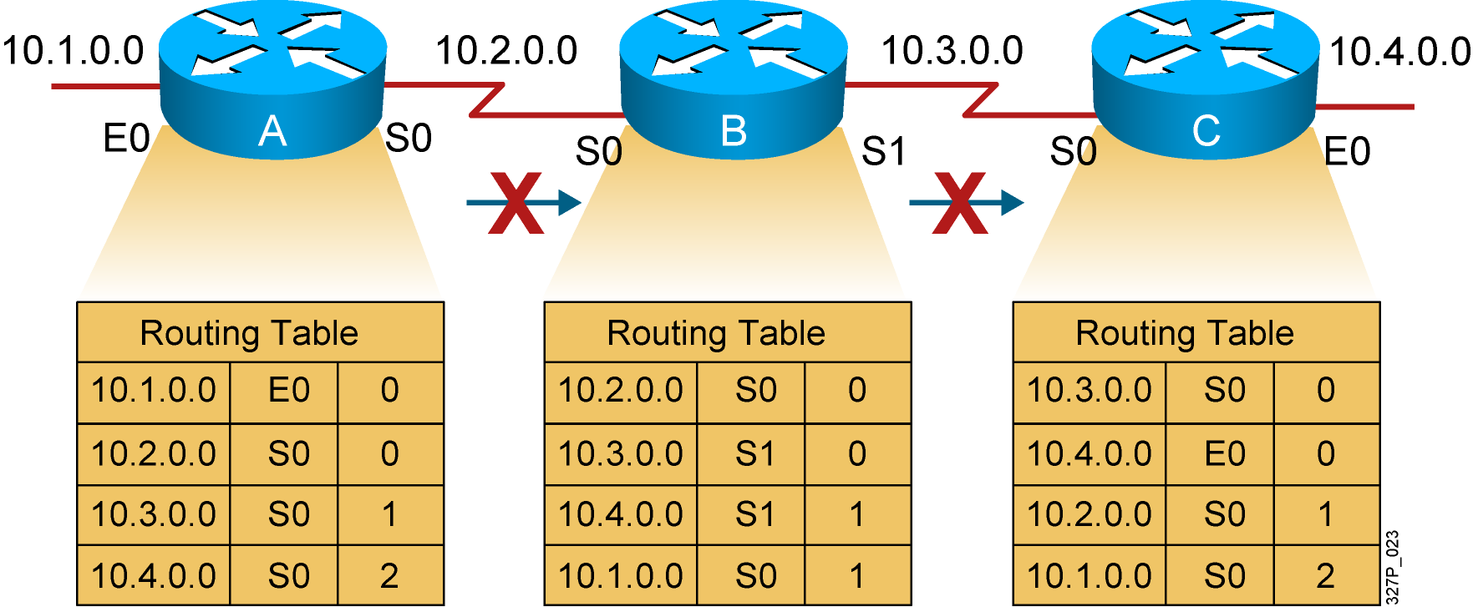
解决方法：水平分割
不会接收到由自身传达出去的路由信息
Notes:
Purpose: This figure introduces the corrective measure known as “split horizon.” The split horizon technique attempts to solve routing loops.
Emphaisze: The split horizon technique attempts to eliminate routing loops and speed up convergence. The rule of split horizon is that it is never useful to send information about a route back in the direction from which the original packet came. In the example:
Router C originally announced a route to network 10.4.0.0 to router B. It makes no sense for router B to announce to router C that router B has access to network 10.4.0.0 through router C.
Given that router B passed the announcement of its route to network 10.4.0.0 to router A, it makes no sense for router A to announce its distance from network 10.4.0.0 to router B.
Because router B has no alternative path to network 10.4.0.0, router B concludes that network 10.4.0.0 is inaccessible.
In its basic form, the split horizon technique simply omits from the message any information about destinations routed on the link. This strategy relies either on routes never being announced or on old announcements fading away through a timeout mechanism.
Split horizon also improves performance by eliminating unnecessary routing updates. Under normal circumstances, sending routing information back to the source of the information is unnecessary.

Slide 38
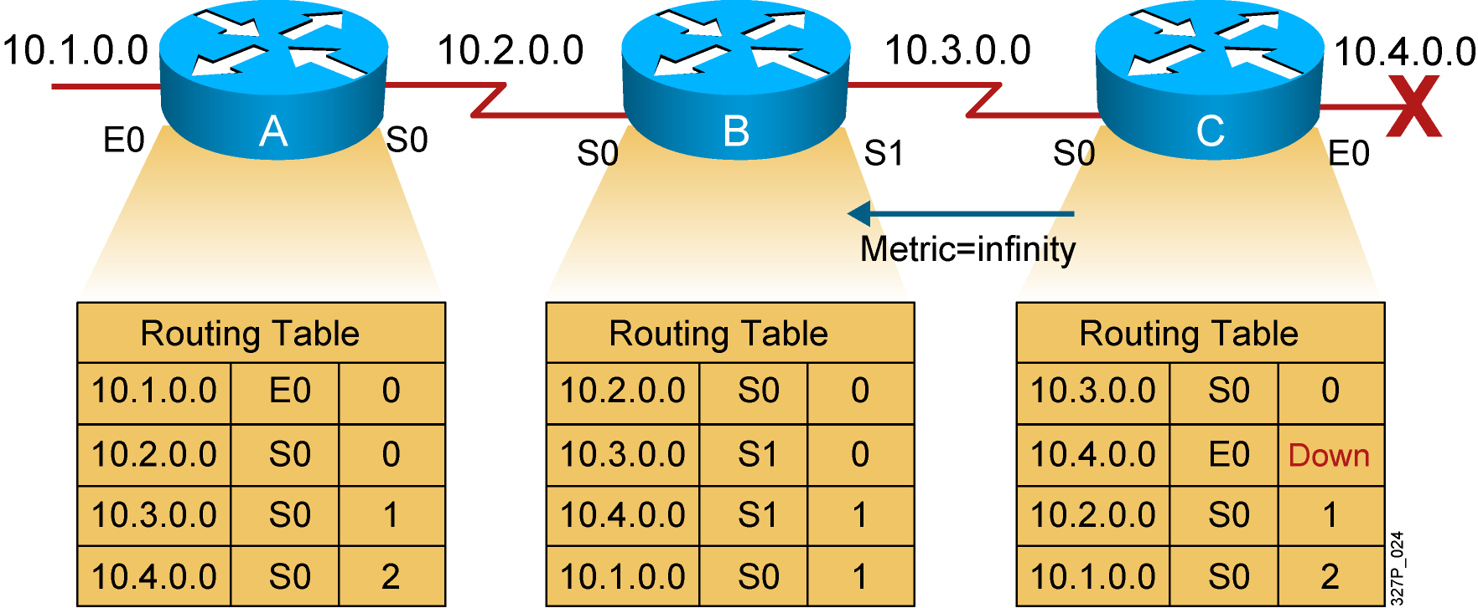
解决方法：路由毒杀
路由器将该路由信息的跳数标记为无限大
Notes:
Purpose: This figure expands on the split horizon technique by adding the concept of poisonous reverse updates.
Emphasize: Route poisoning closes the potential for longer routing loops. Fast convergence minimizes the chance for a routing loop to occur, but even the smallest interval leaves the possibility open. With a poison route in place, router B can maintain a steadfast entry that network 10.4.0.0 is indeed down.

Slide 39
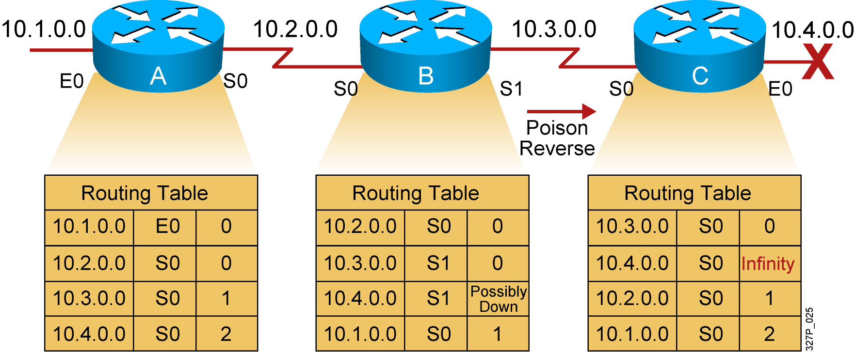
解决方法：反转毒杀
反转毒杀可以超越水平分割
Notes:
Purpose: This figure explains poison reverse..
Emphasize: Poison reverse overrides the split horizon solution.

Slide 40
无 限 计 数
10.1.0.0
10.2.0.0
10.3.0.0
10.4.0.0
X
E0
A
S0
S0
B
S1
S0
C
E0
Routing Table
Routing Table
Routing Table
10.1.0.0
E0
0
10.2.0.0
S0
0
10.3.0.0
S0
0
10.2.0.0
S0
0
10.3.0.0
S1
0
10.4.0.0
S0
4
10.3.0.0
S0
1
10.4.0.0
S1
5
10.2.0.0
S0
1
10.4.0.0
S0
6
10.1.0.0
S0
1
10.1.0.0
S0
2
10.4.0.0 网络的数据将在路由器 A, B, 和 C 之间循环
10.4.0.0 网络的跳数将无限大
Notes:
Purpose: This figure describes another of the general problems that a distance vector protocol could face without the corrective influence of some countermeasure.
Emphasize: Both routers conclude that the best path to network 10.4.0.0 is through each other and continue to bounce packets destined for network 10.4.0.0 between each other, incrementing the distance vector by 1 each time.
This condition, called count-to-infinity, continuously loops packets around the network, despite the fundamental fact that the destination network 10.4.0.0 is down. While the routers are counting to infinity, the invalid information allows a routing loop to exist.
A related concept is the Time-to-Live (TTL) parameter. The TTL is a packet parameter that decreases each time a router processes the packet. When the TTL reaches zero, a router discards or drops the packet without forwarding it. A packet caught in a routing loop is removed from the internetwork when its TTL expires.

Slide 41
无 限 计 数
路由循环的问题也可用描述为跳数无限(counting to infinity).其中的1个解决办法就是定义最大跳数(maximum hop count).
RIP是这样定义最大跳数的:最大跳数为15,第16跳为不可达。但还是不能从本质上去掉路由循环

Slide 42

解决方法：保持关闭 计时
Network 10.4.0.0
is unreachable
Update after
hold-down Time
10.1.0.0
10.2.0.0
10.3.0.0
10.4.0.0
X
E0
A
S0
S0
B
S1
S0
C
E0
Update after
hold-down Time
Network 10.4.0.0 is down
then back up
then back down
路由器在Hold-Down时间内将该条记录标记为possibly down以使其它路由器能够重新计算网络结构的变化
Notes:
Purpose: This figure describes how hold-down timers avoid the general problems that a routing protocol could face.
Emphasize: Hold-down timers are used to prevent regular update messages from inappropriately reinstating a route that may have gone bad.
Hold-downs tell routers to hold any changes that might affect routes for some period of time.
The hold-down period is usually calculated to be just greater than the period of time necessary to update the entire network with a routing change.
Note: A network administrator can configure the hold-down timers on several routers to work together in tandem.

Slide 43
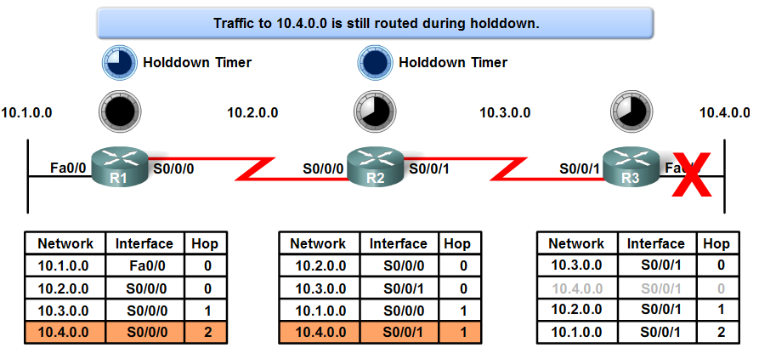
Hold-Down 计时
抑制计时器可用来防止定期更新消息错误地恢复某条可能已经发生故障的路由。

Slide 44
RIP 定时器
RIP使用4种不同的计时来调节它的性能：
1.路由更新定时器(route update timer)：30s
2.路由失效定时器(route invalid timer):180s
3.保持失效定时器(holddown timer):180s
4.路由刷新定时器(route flush timer):240s

Slide 45
动态路由配置
Router(config)#router protocol [keyword]
  指定IP路由协议
Router(config-router)#network network-number
指定与路由器直接相连的网络
Notes:
Purpose: This figure shows the dynamic routing configuration commands.
Emphasize:
The router command starts a routing process. Field descriptions are
protocol—one of the following: RIP, IGRP, HELLO, OSPF, BGP, EGP
autonomous system—used with protocols which require an AS such as IGRP and BGP.
A proper understanding of these commands will avoid many problems in the labs.
The network statement contains no subnetting information. Networks are directly connected and are specified as the major Class A, B, or C network numbers
Transition: The next section describes the RIP routing protocol.

Slide 46
RIP 配 置
Router(config)#router rip
  激活RIP协议
Router(config-router)#network network-number
选择所能到达的网络
必须是有效的网络
Notes:
Purpose: This figure presents the Cisco IOS commands used to configure RIP.
Emphasize: The figure shows the router rip command and the network network-number command. A proper understanding of these commands will save many problems in the lab.
Point out that the network statement contains no subnetting information.
Networks are directly connected and are specified as a Class A, B, or C network number.
Transition:
An example of configuration follows.

Slide 47
RIP 配置举例
E0
S2
S2
S3
S3
E0
172.16.1.0
A
B
C
192.168.1.0
172.16.1.1
10.1.1.1
10.1.1.2
10.2.2.2
10.2.2.3
192.168.1.1
router rip
network 172.16.0.0
network 10.0.0.0
router rip
network 192.168.1.0
network 10.0.0.0
2.3.0.0
2.3.0.0
router rip
network 10.0.0.0
Notes:
Purpose: The figure shows how the RIP commands operate on the example network.
Emphasize:
An administrator only specifies directly connected networks that he wishes to publish to other routers.
Without the network command, nothing is advertised. With a network command, the router will advertise every subnet within the Class A, B, or C network specified in the configuration.

Slide 48
查看RIP信息
E0
S2
S2
S3
S3
E0
172.16.1.0
A
B
C
192.168.1.0
172.16.1.1
10.1.1.1
10.1.1.2
10.2.2.2
10.2.2.3
192.168.1.1
RouterA#sh ip protocols
Routing Protocol is "rip"
Sending updates every 30 seconds, next due in 0 seconds
Invalid after 180 seconds, hold down 180, flushed after 240
Outgoing update filter list for all interfaces is
Incoming update filter list for all interfaces is
Redistributing: rip
Default version control: send version 1, receive any version
Interface Send Recv Key-chain
Ethernet0 1 1 2
Serial2 1 1 2
Routing for Networks:
10.0.0.0
172.16.0.0
Routing Information Sources:
Gateway Distance Last Update
10.1.1.2 120 00:00:10
Distance: (default is 120)
Notes:
Purpose: This figure shows how the show ip protocol command is used to monitor RIP operation.
Emphasize: The command displays the routing protocols that are active on the router for IP. It also gives network and timer information.
Point out the timing information.
Point out the list of networks for which the router is injecting routes.
Point out the administrative distance metric.

Slide 49
查看路由表
E0
S2
S2
S3
S3
E0
172.16.1.0
A
B
C
192.168.1.0
172.16.1.1
10.1.1.1
10.1.1.2
10.2.2.2
10.2.2.3
192.168.1.1
RouterA#sh ip route
Codes: C - connected, S - static, I - IGRP, R - RIP, M - mobile, B - BGP
D - EIGRP, EX - EIGRP external, O - OSPF, IA - OSPF inter area
N1 - OSPF NSSA external type 1, N2 - OSPF NSSA external type 2
E1 - OSPF external type 1, E2 - OSPF external type 2, E - EGP
i - IS-IS, L1 - IS-IS level-1, L2 - IS-IS level-2, * - candidate default
U - per-user static route, o - ODR
T - traffic engineered route
Gateway of last resort is not set
172.16.0.0/24 is subnetted, 1 subnets
C 172.16.1.0 is directly connected, Ethernet0
10.0.0.0/24 is subnetted, 2 subnets
R 10.2.2.0 [120/1] via 10.1.1.2, 00:00:07, Serial2
C 10.1.1.0 is directly connected, Serial2
R 192.168.1.0/24 [120/2] via 10.1.1.2, 00:00:07, Serial2
Notes:
Purpose: This figure displays the show ip route command which displays the contents of the router’s IP routing table.
Emphasize: Discuss the IP routing table in detail. Show the locations of hop count (metric) and the administrative distance (120).
Discuss the following fields:
R—Refers to routes learned from RIP.
via—Refers to the router that informed us about this route.
00:00:07 timer value—RIP updates are every 30 seconds. Ask, “How long until the next update?”
the interfaces to used for the best path

Slide 50
debug ip rip 命令
E0
S2
S2
S3
S3
E0
172.16.1.0
A
B
C
192.168.1.0
172.16.1.1
10.1.1.1
10.1.1.2
10.2.2.2
10.2.2.3
192.168.1.1
RouterA#debug ip rip
RIP protocol debugging is on
RouterA#
00:06:24: RIP: received v1 update from 10.1.1.2 on Serial2
00:06:24: 10.2.2.0 in 1 hops
00:06:24: 192.168.1.0 in 2 hops
00:06:33: RIP: sending v1 update to 255.255.255.255 via Ethernet0 (172.16.1.1)
00:06:34: network 10.0.0.0, metric 1
00:06:34: network 192.168.1.0, metric 3
00:06:34: RIP: sending v1 update to 255.255.255.255 via Serial2 (10.1.1.1)
00:06:34: network 172.16.0.0, metric 1
Notes:
Purpose: This figure shows the debug ip rip command.
Emphasize: Explain that debug commands also provide information for monitoring IP.
The first highlighted line lists the source of the updates. The router returned information about two destinations.
The last highlighted line shows the broadcast address to which the router sent updates.

Slide 51
Configuring RIP Routing
RouterA(config)#router rip
RouterA(config-router)#network 192.168.10.0
RouterA(config-router)#network 192.168.20.0
RouterA(config-router)#^Z
RouterA#
RouterB(config)#router rip
RouterB(config-router)#network 192.168.20.0
RouterB(config-router)#network 192.168.30.0
RouterB(config-router)#network 192.168.40.0
RouterB(config-router)#^Z
RouterB#
RouterC(config)#router rip
RouterC(config-router)#network 192.168.50.0
RouterC(config-router)#network 192.168.40.0
RouterC(config-router)#^Z
RouterC#

Slide 52
Verifying the RIP Routing Tables
验证配置好的路由信息,如下:
RouterA#sh ip route
(略)
R 192.168.50.0 [120/2] via 192.168.20.2, 00:00:23, Serial0/0
(略)
注意R代表的是RIP,[120/2]分别代表AD和度,在这里,度即为跳数.

Slide 53
抑制RIP更新的传播
如果你想阻止RIP更新信息传播到LANs和WANs上,可以使用
passive-interface命令,这条命令可以防止RIP更新信息广播从你定义了的接口上发送出去,但是这个接口仍然可以接受到更新信息,如下:
RouterA(config)#router rip
RouterA(config-router)#network 192.168.10.0
RouterA(config-router)#passive-interface s 0/0

Slide 54
结束

